Slide 1

Medicine Overdose Prediction Using Machine Learning
Presented by:
Aditya Mishra (250260825001)
Vidyuth Ramachandran (250260825014)
Batch : DBDA-Feb2025
Under the Guidance of:
Dr. Sumithra Radhakrishnan
(Mentor, C-DAC ACTS Chennai)
Centre for Development of Advanced Computing (C-DAC)
Advanced Computing Training School (ACTS), Chennai

Slide 2
Project Abstract
Problem: The opioid epidemic is a critical public health challenge. There's a growing need for predictive models to identify individuals at risk of opioid misuse
Objective: To develop a data-driven approach using machine learning to forecast opioid-related outcomes
Methodology: Utilized a diverse dataset including demographic information, medical history, and prescription records. The model focuses on identifying at-risk individuals while differentiating between therapeutic use and potential misuse
Key Features: Emphasizes model interpretability, privacy-preserving techniques, and evaluation using metrics like sensitivity, specificity, and ROC curve
Contribution: This work presents a scalable, interpretable, and ethical predictive solution to support proactive public health strategies against opioid misuse

Slide 3
Introduction and Problem Statement
The Crisis: Drug overdose is a leading cause of death for individuals under 50 globally, with opioids being a major contributor. Provisional CDC data indicates over 80,000 drug overdose deaths in the U.S. in 2024
The Challenge: Public health organizations lack timely and adequate data to address the opioid crisis effectively. Current systems are often reactive, making it difficult to detect emerging overdose hotspots
Problem Statement: The rising number of drug overdose fatalities highlights an urgent need for proactive and data-driven intervention. Existing machine learning models often suffer from slow learning rates and an inability to detect emerging trends early

Slide 4
Project Objectives & Scope
Primary Objective:
To investigate, develop, and analyze machine learning models for predicting drug use and potential overdoses by integrating diverse data from sources like healthcare records.
Scope of the Project:
Clinical Diagnosis: Assist doctors in analyzing patient data to identify at-risk individuals
Medicinal Combination Testing: Analyze how combinations of different drugs contribute to overdose risk
Public Health Analysis: Allow officials to monitor, predict, and respond to overdose trends across different locations

Slide 5
Literature Survey & Research Gap
Previous Work:
Various machine learning algorithms have been used to predict opioid prescription patterns
IEEE 2023: A deep learning framework using multimodal healthcare data showed high accuracy but lacked scalability for real-time public health deployment
Other approaches like feed-forward neural networks, Naive Bayes, and MLP models faced challenges with convergence, handling complex data, and classification accuracy
Unsupervised models like K-Means and DBSCAN showed limited use in early detection
Identified Research Gaps:
Slow learning and long execution times hinder practical deployment
Low interpretability makes clinical integration difficult
Dependence on clean EHR data limits usability
Lack of real-time performance in many deep learning models

Slide 6
Data Collection & Feature Engineering
Data Collection:
Source: Dataset acquired from Kaggle, containing records on opioid prescription behavior and prescriber attributes in the U.S
Dataset Snapshot:
Date: July 6, 2025
Records: ~25,000 rows
Features: 256 columns
Information Included: Prescriber demographics, specialty, prescription patterns, opioid details, drug names, and cost information
Data Preprocessing:
Tools: Pandas, NumPy, and Scikit-learn in Python
Steps:
Missing Value Treatment: Handled missing values in fields like Gender and Credentials
Categorical Encoding: Converted variables like State and Specialty into a numeric format using Label Encoding
Dropping Irrelevant Columns: Removed identifier columns that don't contribute to prediction

Slide 7
Feature Extraction & Selection
Feature Extraction:
New features were created to enhance the dataset's predictive power
Derived Features:
Opioid Claim Ratio: Opioid Claim Count / Total Claim Count
Average Opioid Cost per Claim: Opioid Cost / Opioid Claim Count
Feature Selection:
A combination of domain knowledge, a correlation matrix, and feature importance scores from a Random Forest model were used to select the most impactful features
Key Predictors Chosen:
Total Claim Count
Opioid Claim Count
Opioid Cost
Days' Supply
Specialty and Credentials

Slide 8
Technology & Architecture
Technology Used:
IDE: Anaconda Navigator with Jupyter Notebook
Programming Language: Python 3.12.11
Libraries:
Pandas & NumPy: For data preprocessing
Scikit-learn: For machine learning (Random Forest classifier)
Matplotlib & Seaborn: For visualization
Pickle: For model serialization
System Architecture:
Data Ingestion & Preprocessing: Data from various sources is collected and cleaned.
Feature Engineering: Features are selected and new ones are created.
Model Training: A Random Forest Classifier is trained on the processed data.
Model Evaluation: Performance is analyzed using classification reports and confusion matrices.
Deployment: The model is serialized for future use

Slide 9
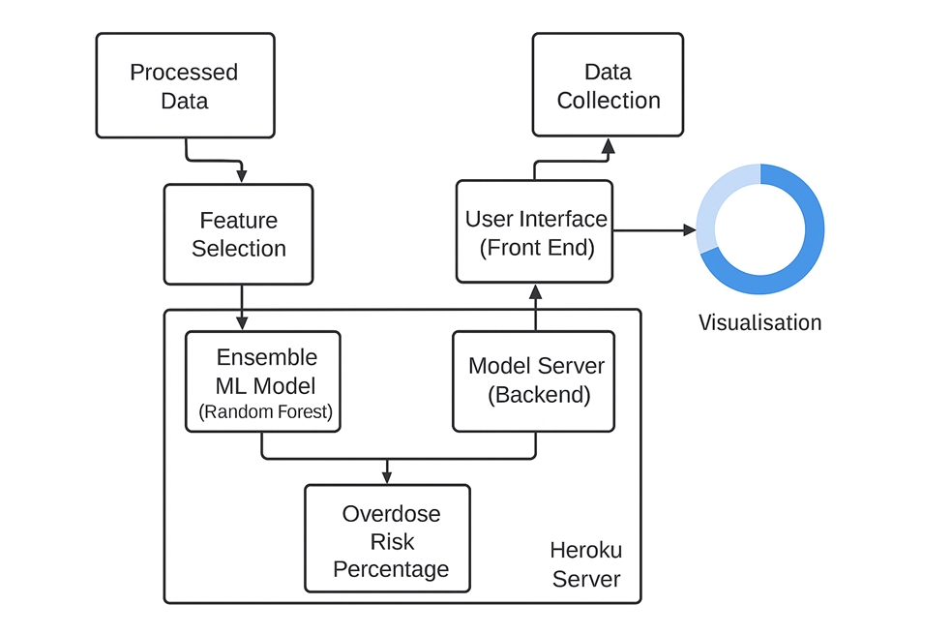

Slide 10
Model Evaluation Metrics
The model was trained on 80% of the data and evaluated on a 20% test set.
Accuracy Score: 0.9204 - Indicates a high proportion of correct predictions.
Precision Score: 0.9578 - High accuracy of positive predictions.
Recall Score: 0.9043 - The model correctly identified over 90% of actual positives.
F1-Score: 0.9303 - A strong harmonic mean of precision and recall.
Confusion Matrix:
True Positives (TP): 2659 (Correctly predicted opioid prescribers)
True Negatives (TN): 1946 (Correctly predicted non-opioid prescribers)
False Positives (FP): 116 (Non-prescribers incorrectly labeled as prescribers)
False Negatives (FN): 279 (Actual prescribers incorrectly labeled as non-prescribers)

Slide 11
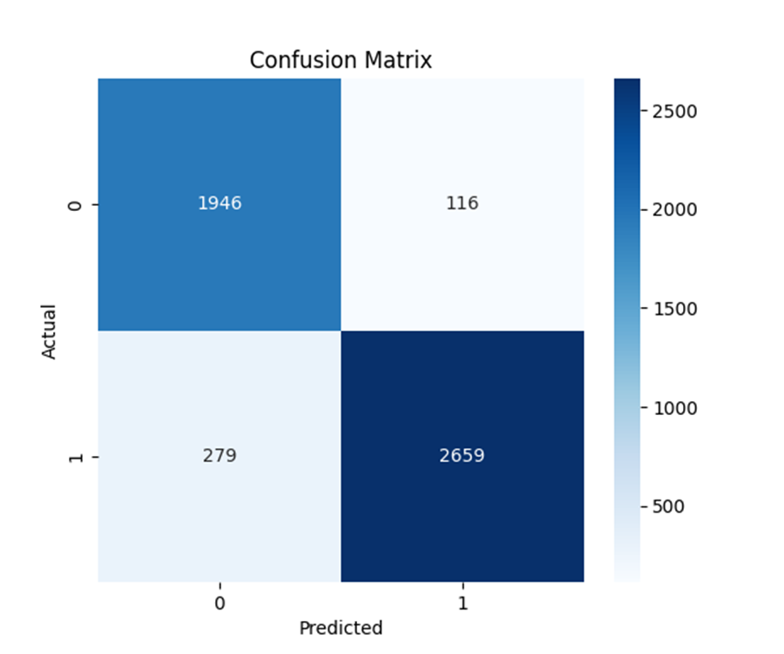

Slide 12
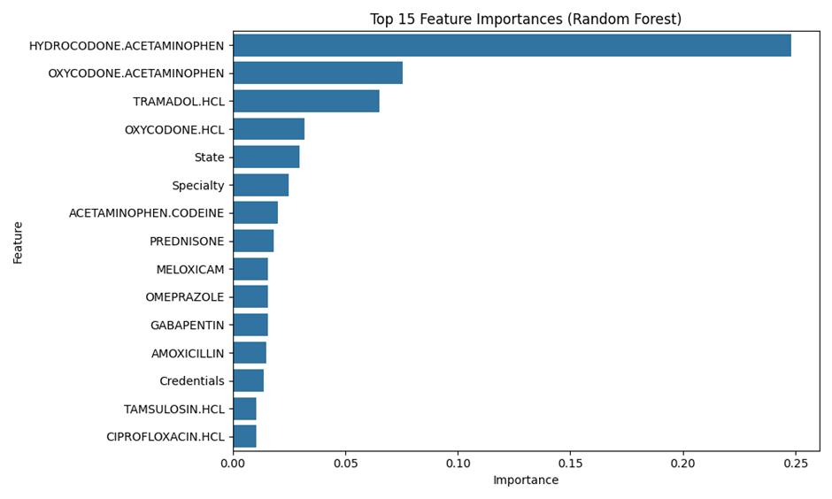
Visualization & Insights
Feature Importance Plot:

Slide 13
This chart shows the top features influencing the model's predictions.
Drugs like Hydrocodone/Acetaminophen and Oxycodone/Acetaminophen are the most significant predictors.
Prescriber's State and Specialty also play a crucial role

Slide 14
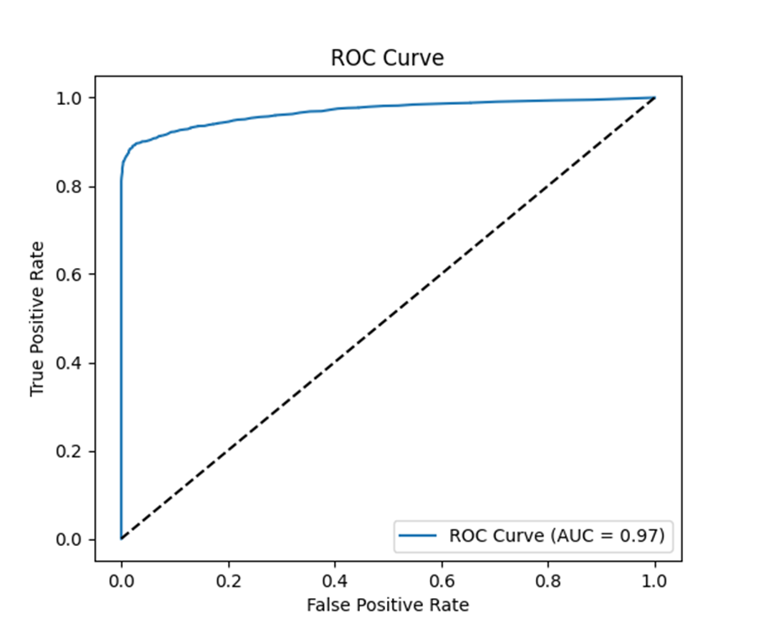
ROC Curve:

Slide 15
AUC Score: 0.97
The high Area Under the Curve (AUC) indicates an excellent measure of separability between the classes, confirming the model's high performance

Slide 16
Conclusion
This project successfully developed a data-driven solution to predict whether a prescriber is likely to issue opioid prescriptions using a Random Forest algorithm.
The model demonstrated high performance in accuracy, precision, and recall.
A key strength is the model's ability to provide insights into the factors driving predictions, making it easier for healthcare professionals and policymakers to understand the results.
This project showcases the potential of machine learning to support public health decisions and mitigate opioid-related risks

Slide 17
Future Work & Limitations
Limitations:
The model's performance depends on the quality, volume, and accessibility of input data.
Challenges include variations in data formats and data-sharing restrictions due to privacy.
The model's accuracy may be influenced by the algorithms used and requires regular updates to account for new trends.
Future Work:
The model can be improved by integrating real-time updates and larger datasets.
With continuous development, it can become a practical tool for monitoring and preventing opioid misuse in communities.

Slide 18
THANK YOU

